Slide 1
Unit 2
Mental health assessment

Slide 2
Psychiatric History Taking
In no other branch of Medicine is the history taking interview as important as in Psychiatry.
A psychiatric interview is usually different from the routine medical interview in several ways.

Slide 3
A psychiatric interview can be different from a medical interview in several ways, some of which can include:
1. Presence of disturbances in thinking, behaviour and emotions can interfere with meaningful communication
2. Collateral information from significant others can be really important
3. Important to obtain detailed information of personal history and pre-morbid personality
4. Need for more subtle observation of patient’s behaviour
5. Difficulty in establishing rapport may be encountered more often
6. Patients may lack insight into their illness and may have poor judgement
7. Usually more important to elicit information regarding stressors and social situation

Slide 4
It is helpful to record patient’s responses verbatim rather than only naming the signs (for example, rather than just writing delusion of persecution, it is better to record in addition: “my neighbour is trying to poison me”).
It is useful to ask open-ended and non-directive questions (for example, “how are you feeling today”?) rather than asking direct, leading questions (for example, “are you feeling sad at present”?).

Slide 5
most important interviewing skills are listening, and demonstrating that you are interested in listening and attending to the patient. It is important to remember that listening is an active, and not a passive, process.
Confidentiality must always be observed. However, in cases of suicidal/homicidal risk and child abuse, an exception may have to be made

Slide 6
Patients suffering from psychiatric disorders are usually no more violent than the general population. However, it is important to ensure safety if any risks are apparent.
A comprehensive psychiatric interview often requires more than one session.

Slide 7
Principles of Psychiatric Assessment
Agreement as process
Privacy and confidentiality
Respect and Consideration
Rapport and Empathy
Patient-nurse relationship
Time and Number of session
  For an initial interview, 45 to 90 minutes
  For confused and pt. in considerable distress, or psychotic- 20 to 30 minutes
Safety and Comfort
  Patient and nurse

Slide 8
Process of Interview
Initiation of interview
  Greeting, welcome
Open ended question

Slide 9
Components of psychiatric history
Identification data
Informant ‘s identification data
A comment should be made regarding the reliability of the information provided. The reliability of the information provided by the informants should be assessed on the following parameters:
  1. Relationship with patient,
  2. Intellectual and observational ability,
  3. Familiarity with the patient and length of stay with
  the patient, and
  4. Degree of concern regarding the patient.

Slide 10
PRESENTING (CHIEF) COMPLAINTS
  Both the patient’s and the informant’s version should be recorded,
  use patient’s own words and to note the duration of each presenting complaint
1. Onset of present illness/symptom.
2. Duration of present illness/symptom.
3. Course of symptoms/illness.
4. Predisposing factors.
5. Precipitating factors (include life stressors).
6. Perpetuating and/or relieving factors.

Slide 11
HISTORY OF PRESENT ILLNESS
When the patient was last well or symptomatic should be clearly noted.
The symptoms of the illness, from the earliest time at which a change was noticed (the onset) until the present time, should be narrated chronologically, in a coherent manner.

Slide 12
The presenting (chief) complaints should be expanded. In particular, any disturbances in physiological functions such as sleep, appetite and sexual functioning should be enquired.
One should always enquire about the presence of suicidal ideation, ideas of self-harm and ideas of harm to others with details about any possible intent and/or plans.
It is also essential to consider and record any important negative history (such as history of alcohol/ drug use in new onset psychosis).

Slide 13
History of past illness
Any medical or psychiatric disorders.
Any history of surgery.
Any previous hospitalization.
Any history of any other treatments.

Slide 14
Family history
Family history usually includes the ‘family of origin’ (i.e. the patient’s parents, siblings, grandparents, uncles, etc.).
The ‘family of procreation’ (i.e. the patient’s spouse, children and grandchildren) is conventionally recorded under the heading of personal history.

Slide 15
Family history is usually recorded under the following headings:
Family structure: Drawing of a ‘family tree’ (pedigree chart)
It should be noted whether the family is a nuclear, extended nuclear or joint family. Any consanguineous relationships should be noted.
The age and cause of death (if any) of family members should be asked.

Slide 16
Family history of similar or other psychiatric illnesses, major medical illnesses, alcohol or drug dependence and suicide (and suicidal attempts) should be recorded.
Current social situation: Home circumstances,per capita income, socioeconomic status, leader of the family (nominal as well as functional) and current attitudes of family members towards the patient’s illness should be noted.

Slide 17
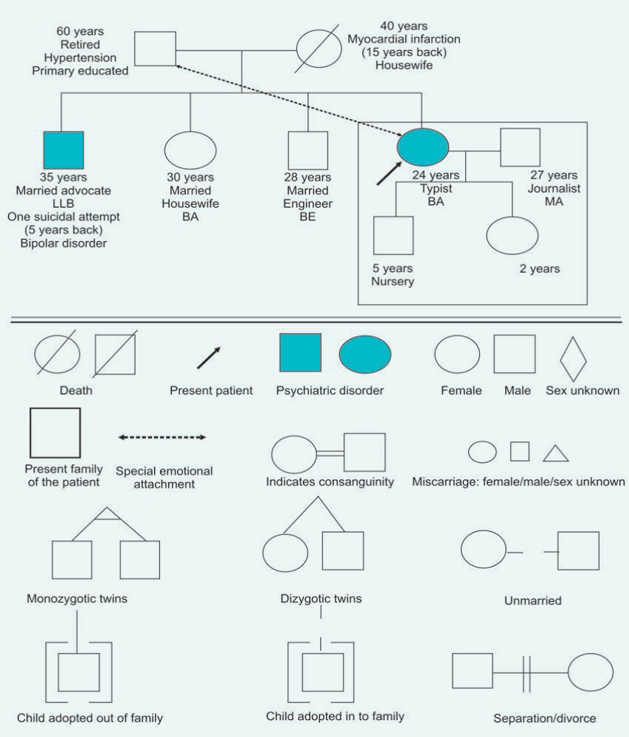

Slide 18
PERSONAL AND SOCIAL HISTORY
In a younger patient, it is often possible to give more attention to details regarding earlier personal history. In older patients, it is sometimes harder to get a detailed account of the early childhood history.

Slide 19
Perinatal History
Difficulties in pregnancy (particularly in the first three months of gestation) such as any febrile illness, medications, drugs and/or alcohol use; abdominal trauma, any physical or psychiatric illness should be asked.
Other relevant questions may include whether the patient was a wanted or unwanted child, date of birth, whether delivery was normal, any instrumentation needed, where born (hospital or home), any perinatal complications (cyanosis, convulsions, jaundice), APGAR score (if available), birth cry (immediate or delayed), any birth defects, and any prematurity.

Slide 20
Childhood History
Whether the patient was brought up by mother or someone else, breastfeeding, weaning and any history suggestive of maternal deprivation should be asked.
The age of passing each important developmental milestone should be noted.
The age and ease of toilet training should be asked.
The occurrence of neurotic traits should be noted.
(stuttering, stammering, tics, enuresis, encopresis, night terrors, thumb sucking, nail biting, head banging, body rocking, morbid fears or phobias, somnambulism, temper tantrums, and food fads)

Slide 21
Educational History
The age of beginning and finishing formal education, academic achievements and relationships with peers and teachers, should be asked.
Any school phobia, non-attendance, truancy, any
learning difficulties and reasons for termination of studies (if occurs prematurely) should be noted.

Slide 22
Play History
The questions to be asked include, what games were played at what stage, with whom and where. Relationships with peers, particularly the opposite sex, should be recorded.
The evaluation of play history is obviously more important in the younger patients.

Slide 23
Puberty
The age at menarche, and reaction to menarche (in females), the age at appearance of secondary sexual characteristics (in both females and males), nocturnal emissions (in males), masturbation and any anxiety related to changes in puberty should be asked.

Slide 24
Menstrual and Obstetric History
The regularity and duration of menses, the length of each cycle, any abnormalities, the last menstrual period, the number of children born, and termination of pregnancy (if any) should be asked for.

Slide 25
Occupational History
The age at starting work; jobs held in chronological order; reasons for changes; job satisfactions; ambitions; relationships with authorities, peers and subordinates; present income; and whether the job is appropriate to the educational and family background, should be asked.

Slide 26
Sexual and Marital History
Sexual information, how acquired and of what kind; masturbation (fantasy and activity); sex play, if any; adolescent sexual activity; pre marital and extramarital sexual relationships, if any; sexual practices (normal and abnormal); and any gender identity disorder, are the areas to be enquired about.
The duration of marriage(s) and/or relationship(s); time known the partner before marriage; marriage arranged by parents with or without consent, or by self-choice with or without parental consent; number of marriages, divorces or separations; role in marriage; interpersonal and sexual relations; contraceptive measures used; sexual satisfaction; mode and frequency of sexual intercourse; and psychosexual dysfunction (if any) should be asked. Conventionally, the details of the ‘family of procreation’ are recorded here.

Slide 27
Premorbid Personality (PMP)
1. Interpersonal relationship: Interpersonal relationships with family members, friends, and work colleagues; introverted/extroverted; ease of making and maintaining social relationships.
2.Use of leisure time: Hobbies; interests; intellectual activities; energetic/ sedentary.
3. Predominant mood: Optimistic/pessimistic; stable/prone to anxiety; cheerful/despondent; reaction to stressful life events.

Slide 28
4. Attitude to self and others: Self-confidence level; self-criticism; self-consciousness; self-centered/ thoughtful of others; self-appraisal of abilities, achievements and failures.
5. Attitude to work and responsibility: decision
making; acceptance of responsibility; flexibility;
foresight.
6. Religious beliefs and moral attitudes
7. Fantasy life: Sexual and nonsexual fantasies;
8.Habits: Food fads; alcohol; tobacco; drugs; sleep.

Slide 29
ALCOHOL AND SUBSTANCE HISTORY
Although alcohol and drug history is often elicited as a part of personal history, it is often customary to record it separately.
Alcohol and drugs can often contribute to causation of several psychiatric symptoms and are often present co-morbidly alongside many psychiatric diagnoses.

Slide 30
PHYSICAL EXAMINATION
A detailed general physical examination (GPE) and systemic examination is a must in every patient.
Physical disease, which is aetiologically important (for causing psychiatric symptomatology), or accidentally co-existent, or secondarily caused by the psychiatric condition or treatment, is often present and can be detected by a good physical examination.

Slide 31
Mental Status Examination
Mental status examination is a standardised format in which the clinician records the psychiatric signs and symptoms present at the time of the interview.
Some areas, however, may deserve more emphasis according to the clinical impressions that may arise from the history.

Slide 32
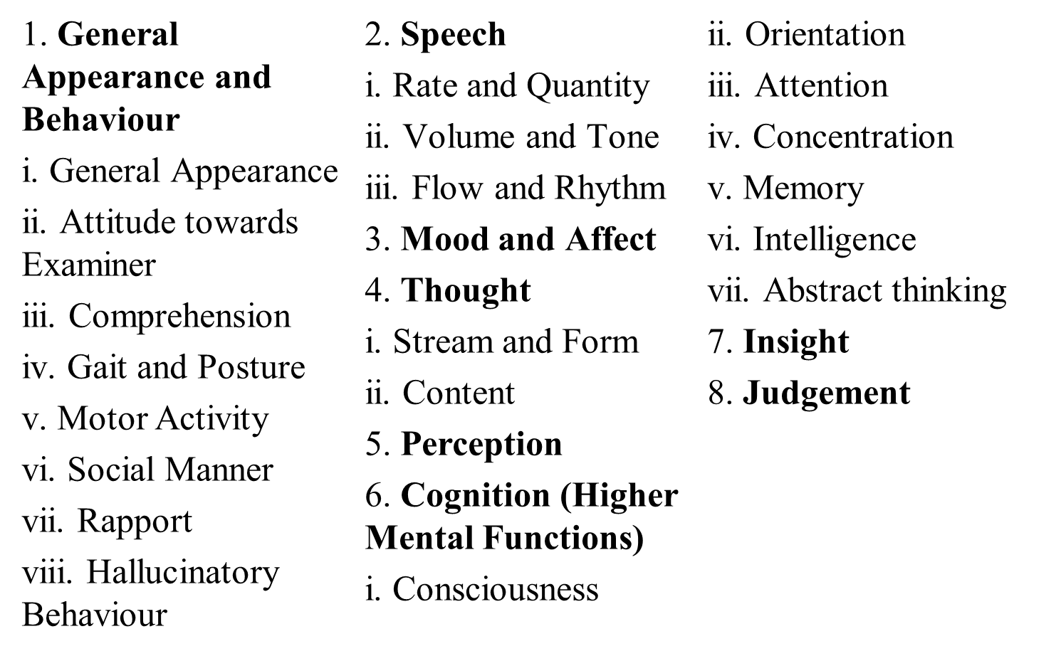
Mental Status Examination

Slide 33
General appearance
Physique and body habitus (build) and physical appearance (approximate height, weight, and appearance),
Looks comfortable/uncomfortable,
Physical health,
Grooming, Hygiene, Self-care,
Dressing (adequate, appropriate, any peculiarities),
Effeminate/masculine

Slide 34
Attitude towards examiner
Cooperation/guardedness/evasiveness/ hostility/combativeness/ haughtiness, Attentiveness,
Appears interested/disinterested/apathetic,
Comprehension
Intact/impaired (partially/fully)
Gait and posture
Normal or abnormal (way of sitting, standing, walking, lying)

Slide 35
Motor activity
Increased/decreased,
Excitement/stupor,
Abnormal involuntary movements (AIMs) such as tics, tremors, akathisia,
Restlessness/ill at ease,
Catatonic signs
(mannerisms, stereotypies, posturing, waxy flexibility, negativism, ambitendency, automatic obedience, stupor, echopraxia, psychological pillow, forced grasping)
Conversion and dissociative signs (pseudo seizures, possession states),
Social withdrawal, Autism,
Compulsive acts, rituals or habits (for example, nail biting),

Slide 36
Social manner and non-verbal behaviour
Increased, decreased, or inappropriate behaviour
Eye contact (gaze aversion, staring vacantly, staring at the examiner, hesitant eye contact, or normal eye contact).

Slide 37
Rapport
Whether a working and empathic relationship can be established with the patient, should be mentioned.
Hallucinatory Behaviour
Smiling or crying without reason, muttering or talking
to self (non-social speech).
Odd gesturing in response to auditory or visual hallucinations

Slide 38
Speech
Rate and quantity of speech
Whether speech is present or absent (mutism),
If present, whether it is spontaneous, whether productivity is increased or decreased,
Rate is rapid or slow (its appropriateness), Pressure of speech or poverty of speech.
Reaction time

Slide 39
Volume and tone of speech
Increased/decreased (its appropriateness),
Low/high/normal pitch
Flow and rhythm of speech
Smooth/hesitant, Blocking (sudden), Stuttering/Stammering/Cluttering, Circumstantiality, Tangentiality, Verbigeration, Stereotypies (verbal), Flight of ideas, Clang associations

Slide 40
Mood and Affect
Mood is the pervasive feeling tone which is sustained (lasts for some length of time) and colours the total experience of the person.
Affect, on the other hand, is the outward objective expression of the immediate, cross-sectional experience of emotion at a given time.

Slide 41
The assessment of mood includes testing the quality of mood, which is assessed subjectively (‘how do you feel’) and objectively (by examination).
The other components are stability of mood (over a period of time), reactivity of mood (variation in mood with stimuli), and persistence of mood (length of time the mood lasts).

Slide 42
The affect is similarly described under quality of affect, range of affect (of emotional changes displayed over time), depth or intensity of affect (normal, increased or blunted) and appropriateness of affect (in relation to thought and surrounding environment).
Mood is described as general warmth, euphoria, elation, exaltation and/or ecstasy (seen in severe mania) in mania; anxious and restless in anxiety and depression; sad, irritable, angry and/or despaired in depression; and shallow, blunted, indifferent, restricted, inappropriate and/or labile in schizophrenia.

Slide 43
Thought
Stream and form of thought
Content of thought
Possession of thought

Slide 44
Stream and form of thought
For obvious reasons, the ‘stream of thought’ overlaps with examination of ‘speech’. Spontaneity, productivity, flight of ideas, prolixity, poverty of content of speech, and thought block should be mentioned here.
The presence of neologisms should be recorded here.
The ‘continuity’ of thought is assessed; Whether the thought processes are relevant to the questions asked; Any loosening of associations, tangentiality, circumstantiality, illogical thinking, perseveration is noted.

Slide 45
Content of thought
Any preoccupations;
Obsessions (recurrent, irrational, intrusive, egodystonic ideas);
Contents of phobias (irrational fears);
Delusions (false, unshakable beliefs) or Over-valued ideas; Explore for delusions/ideas of persecution, reference, grandeur, love, jealousy (infidelity), guilt, nihilism, poverty, somatic (hypochondriacal) symptoms, hopelessness, helpless ness, worthlessness, and suicidal ideation.

Slide 46
Thought Possession
Delusions of control, thought insertion, thought withdrawal, and thought broad casting are Schneiderian first rank symptoms (SFRS).

Slide 47
Perception
Hallucinations
  auditory, visual, olfactory, gustatory or tactile domains.
  elementary (only sounds are heard) or complex (voices heard)
Illusions and misinterpretations
Depersonalisation( a state in which one’s thoughts and feelings seem unreal or not to belong to oneself)/derealisation (a feeling that one’s surroundings are not real)
Somatic passivity phenomenon

Slide 48
Somatic passivity phenomenon
Somatic passivity is the presence of strange sensations described by the patient as being imposed on the body by ‘some external agency’, with the patient being a passive recipient.
It is one of the Schneider’s first rank symptoms.

Slide 49
Cognition (Neuropsychiatric) Assessment
Assessment of the cognitive or higher mental functions is an important part of the MSE.
A significant disturbance of cognitive functions commonly points to the presence of an organic psychiatric disorder.
It is usual to use Folstein’s mini mental state examination (MMSE) for a systematic clinical examination of higher mental functions.

Slide 50
Consciousness
The intensity of stimulation needed to arouse the patient should be indicated to demonstrate the level of alertness, for example, by calling patient’s name in a normal voice, calling in a loud voice, light touch on the arm, vigorous shaking of the arm, or painful stimulus.

Slide 51
Grade the level of consciousness: conscious/ confusion/somnolence/clouding/delirium/stupor/coma.
Any disturbance in the level of consciousness should ideally be rated on Glasgow Coma Scale, where a numeric value is given to the best response in each of the three categories (eye opening, verbal, motor).

Slide 52
Orientation
Whether the patient is well oriented to time (test by asking the time, date, day, month, year, season, and the time spent in hospital), place (test by asking the present location, building, city, and country) and person (test by asking his own name, and whether he can identify people around him and their role in that setting).
Disorientation in time usually precedes disorientation in place and person.

Slide 53
Attention
Is the attention easily aroused and sustained; Ask the patient to repeat digits forwards and backwards (digit span test; digit forward and backward test), one at a time (for example, patient may be able to repeat 5 digits forward and 3 digits backwards).
Start with two digit numbers increasing gradually up to eight digit numbers or till failure occurs on three consecutive occasions.

Slide 54
Concentration
Can the patient concentrate; Is he easily distractible;
Ask to subtract serial sevens from hundred (100-7 test), or serial threes from fifty (50-3 test), or to count backwards from 20, or enumerate the names of the months (or days of the week) in the reverse order.
Note down the answers and the time taken to perform the tests.

Slide 55
Memory
a. Immediate Retention and Recall (IR and R)
Use the digit span test to assess the immediate memory; digit forwards and digit backwards subtests (also used for testing attention; are described under attention).
Registration and recall

Slide 56
b. Recent Memory
Ask how did the patient come to the room/hospital;
what he ate for dinner the day before or for breakfast the same morning.

Slide 57
c. Remote Memory
Ask for the date and place of marriage, name and birthdays of children, any other relevant questions from the person’s past.
Note any amnesia (anterograde/ retro grade), or confabulation, if present.

Slide 58
Intelligence
Intelligence is the ability to think logically, act rationally, and deal effectively with environment.
Ask questions about general information, keeping in mind the patient’s educational and social background, his experiences and interests, for example, ask about the current and the past prime ministers and presidents of Nepal, the capital of Nepal, and the name of the various states.
Test for reading and writing; Use simple tests of calculation.

Slide 59
Abstract thinking
Abstract thinking is characterised by the ability to:
a. assume a mental set voluntarily,
b. shift voluntarily from one aspect of a situation to
another,
c. keep in mind simultaneously the various aspects of a situation,
d. grasp the essentials of a ‘whole’ (for example,
situation or concept), and
e. to break a ‘whole’ into its parts.

Slide 60
Abstract thinking testing assesses patient’s concept formation. The methods used are:
a. Proverb Testing: The meaning of simple proverbs (usually three) should be asked.
b. Similarities (and also the differences) between familiar objects should be asked, such as: table/ chair; banana/orange; dog/lion; eye/ear.

Slide 61
Judgement
i. Social judgement is observed during the hospital stay and during the interview session.
ii. Test judgement is assessed by asking the patient what he would do in certain test situations, such as ‘a house on fire’, or ‘a man lying on the road’, or ‘a sealed, stamped, addressed envelope lying on a street’.
ii. Personal Judgment

Slide 62
Insight
Insight is the degree of awareness and under standing that the patient has regarding his illness.
Ask the patient’s attitude towards his present state; whether there is an illness or not; if yes, which kind of illness (physical, psychiatric or both); is any treatment needed; is there hope for recovery; what is the cause of illness.
Depending on the patient’s responses, insight can be graded on a six-point scale

Slide 63
Insight
Insight is rated on a 6-point scale from one to six.
1. Complete denial of illness.
2. Slight awareness of being sick and needing help, but denying it at the same time.
3. Awareness of being sick, but it is attributed to external or physical factors.
4. Awareness of being sick, due to something unknown in self.
5. Intellectual Insight: Awareness of being ill and that the symptoms/failures in social adjustment are due to own particular irrational feelings/thoughts; yet does not apply this knowledge to the current/future experiences.
6. True Emotional Insight: It is different from intellectual insight in that the awareness leads to significant basic changes in the future behaviour.

Slide 64
Mini mental status examination (MMSE)
The MMSE was first published in 1975 as an appendix to an article written by Marshal F. Folstei, Susan Folstei, and Paul R. McHugh.

Slide 65
MMSE
The Mini–Mental State Examination (MMSE) or Folstein test is a 30-point questionnaire that is used extensively in clinical and research settings to measure cognitive impairment. It is commonly used in medicine and allied health to screen for dementia.

Slide 66
Contd…
It is also used to estimate the severity and progression of cognitive impairment and to follow the course of cognitive changes in an individual over time; thus making it an effective way to document an individual's response to treatment.

Slide 67
Administration of the test takes between 5 and 10 minutes and examines functions including;
registration ,
attention,
calculation,
recall,
language,
ability to follow simple commands and
orientation

Slide 68
Advantages
Advantages to the MMSE include requiring no specialized equipment or training for administration, and has both validity and reliability for the diagnosis and longitudinal assessment of Alzheimer's Disease.
Due to its short administration period and ease of use, it is useful for cognitive assessment in the clinician's office space or at the bedside.

Slide 69
Disadvantages
Disadvantages to the utilization of the MMSE is that it is affected by demographic factors; age and education.
MMSE relates to its lack of sensitivity to mild cognitive impairment and its failure to adequately discriminate patients with mild Alzheimer's Disease from normal patients.

Slide 70
Category | Possible points | description
Orientation to time | 5 | From broadest to most narrow. Orientation to time has been correlated with future decline.
Orientation to place | 5 | From broadest to most narrow. This is sometimes narrowed down to streets, and sometimes to floor.
Registration | 3 | Repeating named prompts
Attention and calculation | 5 | Serial sevens, or spelling "world" backwards. It has been suggested that serial sevens may be more appropriate in a population where English is not the first language.

Slide 71
Recall | 3 | Registration recall
Repetition | 1 | Speaking back a phrase
Complex commands . | 6 | Varies. Can involve drawing figure shown
Language | 2 | Naming a pencil and a watch

Slide 72
Interpretation
The following three cut-off levels should be employed to classify the severity of cognitive impairment:
no cognitive impairment=24-30;
mild cognitive impairment=18-23;
severe cognitive impairment=0-17.

Slide 73
Contd…
The MMSE has been able to differentiate different types of dementias.
Studies have found that patients with Alzheimer's disease score significantly lower on orientation to time and place, and recall compared to patients with dementia with Lewy bodies, vascular dementia and Parkinson's disease

Slide 74
EXAMINATION OF UNCOOPERATIVE PATIENTS
When patients are uncooperative for examination we need to record the observations till the patients become cooperative, without leaving any gap in clinical observation. Kirby’s method for examination of uncooperative patient is used in such situations, usual situations are when the patient is in stupor or in catatonia.

Slide 75
The examination is recorded under the following headings:
General reaction and posture
• Spontaneous acts:
o Any occasional show of activities or assaultiveness.
o Is the patient tidy or untidy?
o Does the patient eat voluntarily or should be fed.
o Does the patient dress himself or require assistance.
o Does the actions show initial slowness or consistent slowness throughout?
• Behavior towards the examiners:
o Resistive or evasive, irritable or apathetic or complaint.

Slide 76
• Voluntary postures:
o Comfortable, natural or awkward or constrained.
o What does the patient do when placed in an awkward position?
• Is the behavior constant or changing with time?

Slide 77
Facial movement and expression
• Is the expression being alert, aware, smiling, mask like, placid, sulky, anxious, perplexed, distressed, tearful
• Is the facial expression constant or changing with time?

Slide 78
Eyes and pupils
• Are the eyes open or closed: Is there resistance to open the patients eyes by examiner
• Does he gives attention to examiner and move his eyes with that of object or light source
• Does he have fixed gaze or evasive gaze
• Is there blinking of eyes or flickering of eye lids
• Response to sudden movement of hand towards the patients eyes
• Response of pupils to painful sensory stimulus and corneal reflex

Slide 79
Reaction to examiners questions and tests
• What is the response to simple commands: asking to show tongue, lift the hands
• Presence of negativism – either active or passive uncooperativeness
• Check for presence of automatic obedience, echolalia and echopraxia
• Are the movements of limbs being slow or fast or interrupted

Slide 80
Muscular reactions
• Check for tone of muscles: look for rigidity - lead pipe or cog wheel type, waxy flexibility, gagenhalten, mitgehen and mitmachen
• Is there urinary or fecal incontinence
Emotional responsiveness:
• Emotional Response when family members speak or when personal facts are told
• Response to unexpected stimulus like clapping sound or by switching on lights

Slide 81
Speech:
• Is there any spontaneous speech
• Is the patient mute, if so whether it is consistent present or not
• Is there any effort to speak or make sounds or whisper
Writing:
• Offer the patient a pencil and paper to write his wishes
Vitals:
• Patients Pulse rate, blood pressure, temperature and respirator rate needs to be measured at regular intervals

